Slide 1
Research Practice By N. Sai Charan under
Dr. Abhishek Mishra
Dr. Abhishek Mishra N. Sai Charan
Assistant Professor, M. Engg - Software Systems,
Department of Computer Science & Information Systems Department of Computer Science &
Birla Institute of Technology & Science, Pilani. Information Systems
Birla Institute of Technology & Science, Pilani

Slide 2
Research Topic
Scheduling Directed Acyclic Graphs with Optimal Duplication Strategy on Homogeneous Multiprocessor systems.
Objective: Assigned theoretical task to study the paper carefully and get the experimental results by solving the MILP

Slide 3
Overview of paper
Modern day applications are often implemented on multiprocessor systems i.e tasks of the application are allocated to different processors for execution.
Obtaining the optimal performance on on multiprocessor systems remains challenging due to inter-processor communications between tasks of application.
Inter-processor communications overhead:
Two or more processors requires same Resource.(Contention Problem).
Synchronisation mechanisms comes into play and certain hardware primitives are used to ensure atomic operations and mutual exclusion.
To tackle this overhead, task duplication strategy has been employed in the schedule.

Slide 4
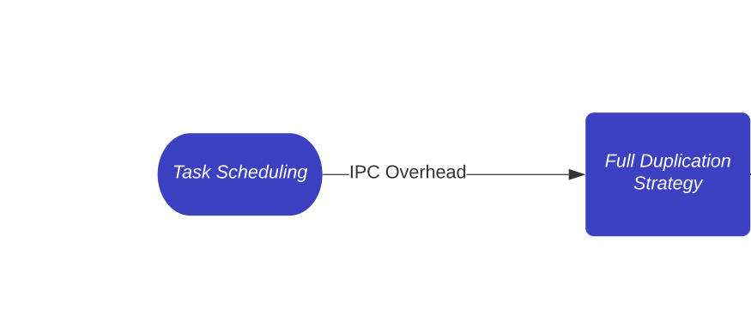

Slide 5
Overview contd.
Task Duplication Strategy:
The communication between tasks assigned to the same processor is considered negligible, whereas tasks allocated to different processors for execution, then, inter-processor communication is inevitable, which delays execution.
Owing to the delay-free shared memory based intra-processor communication, i.e., local communication, part of inter-task communications are made local by allocating the task to multiple processors for execution.
To be a delay free local communication, the source task is duplicated to the processor where the destination task is mapped to, thus removing the communication delay.

Slide 6
Task duplication based scheduling algorithms generate shorter schedules without sacrificing efficiency but leave the computing resources over consumed due to the heavily duplications of tasks.
Issues with Duplication:
Which task(s) to be duplicated?
How many times a task should be duplicated and where it should be duplicated?
How should tasks on each processors be ordered and timed?
How to determine the data precedences among duplications of a task and its successors?

Slide 7
Proposed System:
Finding the optimal duplication-based solution with the minimal schedule makespan remains an issue.
Mixed Integer Linear Programming Approach:
The MILP has been widely studied for the scheduling problem.
Proposed an application-specific knowledge aware MILP for scheduling DAGs.In the formulation, the bi-linear equation is simplified to mitigate the size of the formulation.
This paper proposes a novel Mixed Integer Linear Programming (MILP) formulation, together with a set of key theorems which enable and simplify the MILP formulation and solve the problem with optimality.

Slide 8
Proposed System:
Novel Approach Includes:
Guaranteed to be optimal in terms of schedule length for the duplication--based scheduling problem.
The task duplication is modeled appropriately using the task duplication variable in the formulation, thus resulting in optimal task duplication strategy.
The reformulated data dependence is taken into account without a priori information about task duplication and mapping.
A set of optimality theorems are summarized, which help to enable and simplify the modeling of the problem.

Slide 9
Complete Overview
Task Scheduling
Duplication Strategy
Optimal Duplication (MILP)
IPC Overhead
Tasks are duplicated to processors where dependents exist to avoid IPC (Full Duplication Strategy)
Redundant Duplications are not executed.

Slide 10
Literature Survey
Scheduling is generally classified as three categories, list-based, cluster-based, duplication-based scheduling.
List scheduling technique generally assigns several priorities, e.g., the s-level, b-level and t-level, to tasks of the application, orders the task and then schedules according to the order.
Cluster based scheduling technique tries to bind tasks with heavy intercommunication as a cluster and schedule the cluster to the same processor, so as to reduce inter-processor communication and improve the performance.
Duplication-based scheduling, tasks are allocated to multiple processors for execution to reduce the schedule length.

Slide 11
Literature Survey
Used ILP for the non duplication-based scheduling. An ILP-based DAG mapping algorithm aims at reducing the total communication cost; however, two other aspects of the scheduling, i.e., ordering and timing, are not considered.
Full-duplication strategy: It duplicates immediate and indirect ancestors in a bottom-up fashion recursively.
The Critical Path Fast Duplication (CPFD) algorithm, tries to duplicate the very important parent into the available time slot of the processor until either the time slot is used up or the task start time is not improved any more.
The selective duplication (SD) algorithm, divided into three main steps, i.e. the task sequence generation phase, processor selection phase, and task assignment and duplication phase, was developed to improve the performance by selectively adding duplications of some tasks.

Slide 12
Literature Survey Contd
Drawbacks with Full Duplication
It has larger time complexity.
It incurs redundant duplications, which may increase the schedule length.
Duplication-based Scheduling Algorithm Using Partial Schedules (DUPS):
DUPS uses two stages. The schedule length is minimized by utilizing partial schedules in First phase, the number of processors required is minimized by eliminating and merging these partial schedules in the Second phase.
The Minimized Duplication at Joint node (MDJ) algorithm: Proposes concept of join node. Itschedules join nodes without redundant duplications. In the algorithm, if the ancestor nodes of a join node are duplicated when scheduling the join node, the original allocations of these ancestor nodes are removed using a very efficient method.

Slide 13
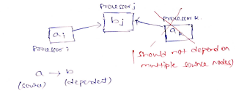
Proposed Optimality Theorems
Lemma I. There is an optimal duplication-based schedule in which no more than one instance of the same task is duplicated to execute on the same processor.
This ensures that each processor have a unique set of tasks.
Theorem I. There is an optimal duplication-based schedule in which each duplication of the destination task of an edge depends on the output data of one and only one duplication of the source task of the edge.
This says that there will be one to one dependency between source and destination tasks if at all dependency exists.

Slide 14
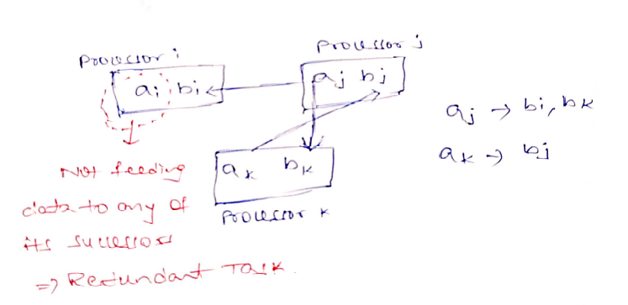
Theorem II. There is an optimal duplication-based schedule in which each duplication of a non-exit task feeds data to at least one duplication of its successors.
This ensures that there will be definite dependency between the source and the duplicated tasks among processors i.e no useless executions taking place.

Slide 15
Theorem III. There is an optimal duplication-based schedule in which: for any pair of different tasks a and b in the DAG, if task b is the only successor of task a, then the data precedence between a and b is obeyed by the partial schedule of the optimal schedule on each processor.
This says that though a,b tasks are mapped to different processors and there might be difference in execution time, but b will be mapped to some other task a on some processor thus satisfying the dependency.
This is represented as drt_{bk} = f_{ai} + w(e) ≥ f_{aj} + w(e) + c(b) + c(a) + w(e), where the data ready time of bk is obtained by redirecting the input data of bk from ai to aj the new maximal data ready time of bk _{i}

Slide 16
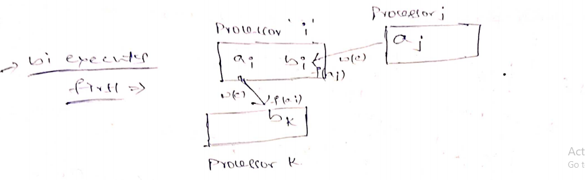

Slide 17
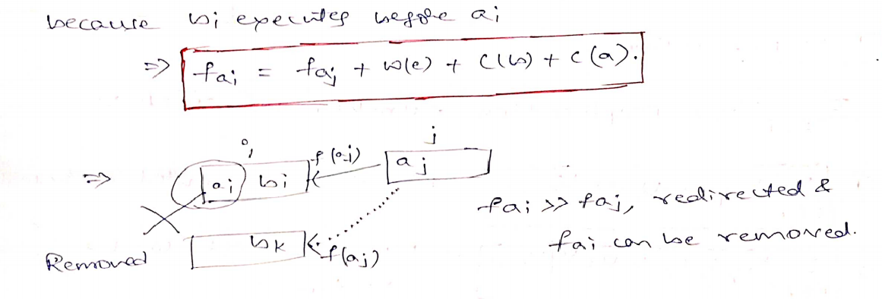

Slide 18
Theorem IV. There is an optimal duplication-based schedule in which the data precedences between the computation-dominated task (CDT) and all its successors are obeyed by the partial schedule of the optimal schedule on each processor.
This means that though there can be more than one successor for a task mapped to a processor and its successors are mapped to different processors.There can be difference in execution times between parent task and its successors but the successors will be mapped to some other duplication of parent task and the dependency will be preserved.
If one dependent task executes before source task, then logically, all its dependent tasks can be mapped to other source making the original source node redundant.

Slide 19
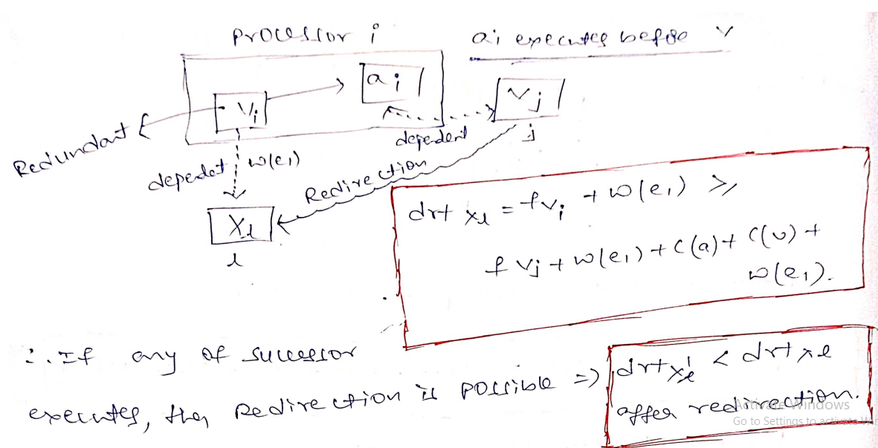

Slide 20
MILP Formulation
Constraints on Order of Task Execution:
Entry task should execute only once.
Non entry task can be executed >= 1 times.
When a redundant duplication is found, its Start Time should be limited to zero i.e the Redundant task never gets executed in the schedule.
If both Source task and Dependent task are mapped to same processor, then their execution should be ordered i.e Source task should execute before the Dependent task.
Since there are dependents to the task, the Finish time of the Source task and Start Times of the Dependent tasks should be ordered.

Slide 21
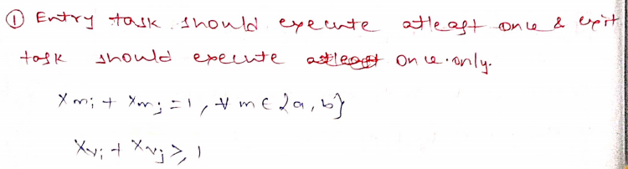
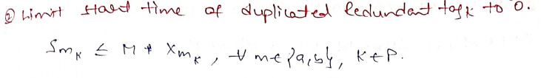
Mathematical Model of Task Execution Constraints.

Slide 22
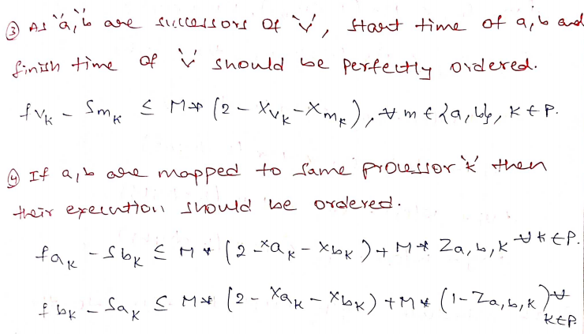
Constraints Contd:

Slide 23
Constraints on Dependencies between Tasks:
There should be atleast one dependent successor task for a source task to be irredundant.
Redundant dependencies should be removed as these result in redundant duplications.
The successor dependent task should depend only on one source task in the schedule.
Since tasks are dependent, the dependent task should start execution right after the finish time of the source task.

Slide 24
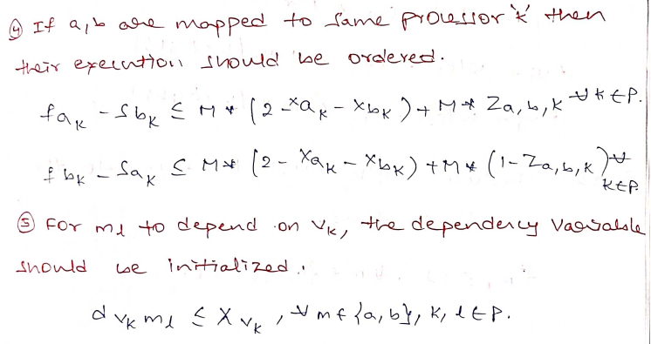
Mathematical Model of Task Dependency Constraints.

Slide 25
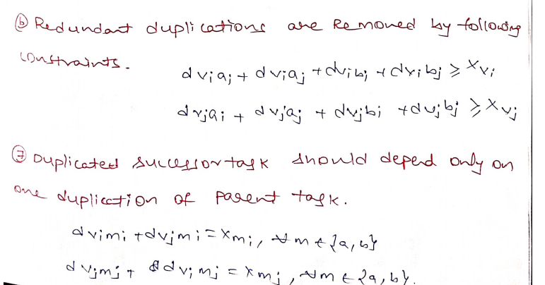
Dependency Constraints Contd:

Slide 26
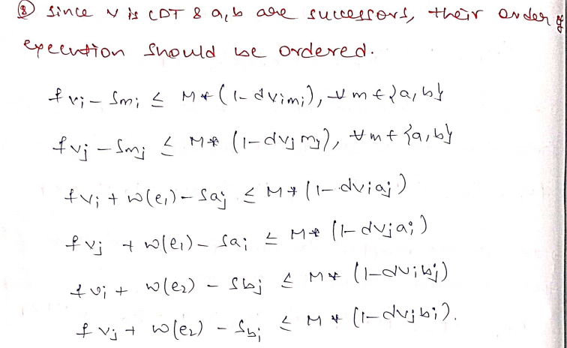
Dependency Constraints Contd:

Slide 27
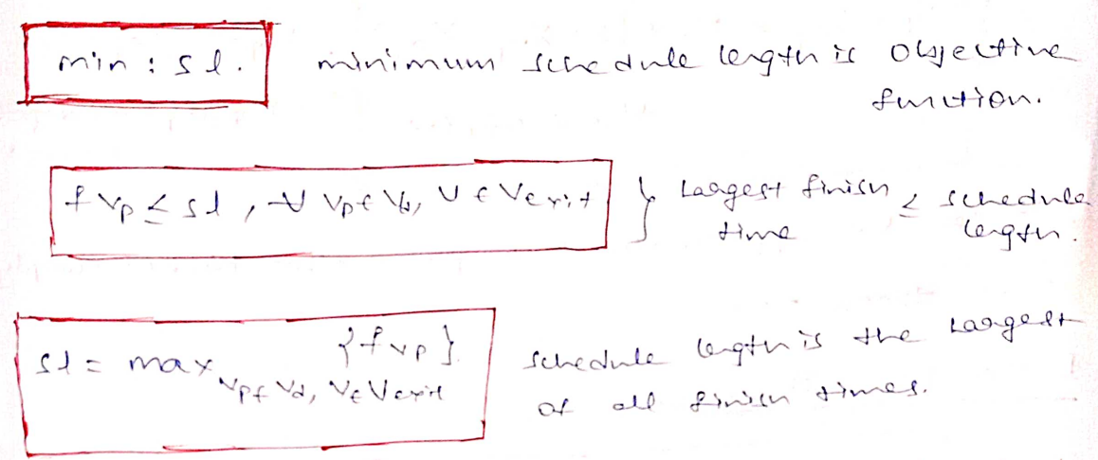
Objective Function
Schedule Length should be equal to the maximum finish time.

Slide 28
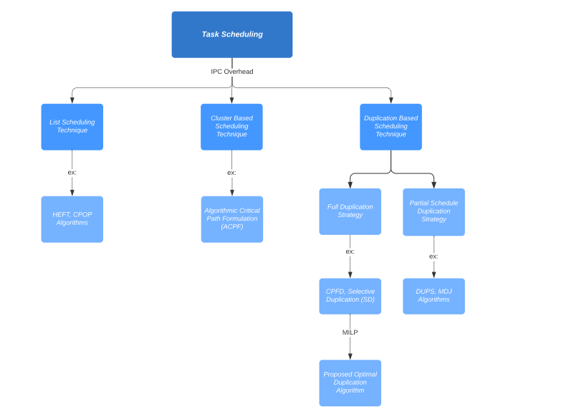
Summary

Slide 29
Topics Presented:
Overview of paper:
Discussed on Task scheduling, IPC, Duplication Strategy.
Proposed System:
Issues with Duplication, MILP formulation of scheduling problem.
Literature Survey:
Types of Scheduling Strategies(List based, Cluster based, Duplication based).
Types of Duplication Strategies(Full duplication, Selective Duplication, Duplication of Partial Schedules).
Proposed Set of 4 Optimality Theorems.
MILP Formulation
Task Execution Constraints, Data Dependency Constraints and Objective Function.

Slide 30
Thank You !!

